Slide 1
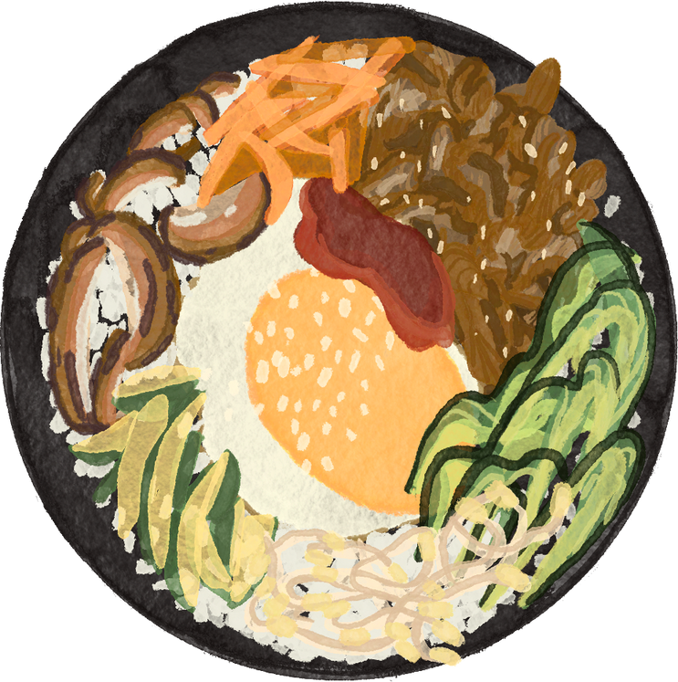





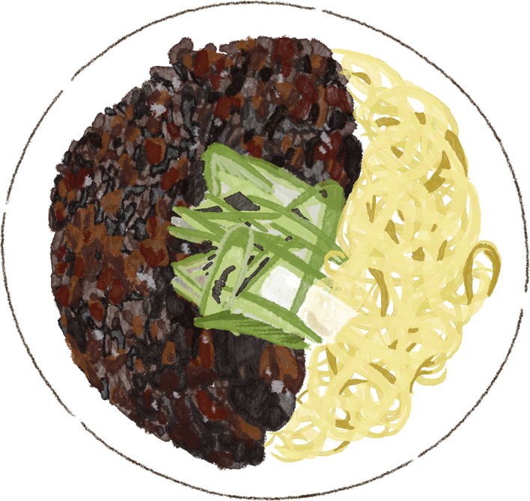

RESTAURANT ANaLYSIS
LET’S START!
KHUSHI JAGNANI

Slide 2
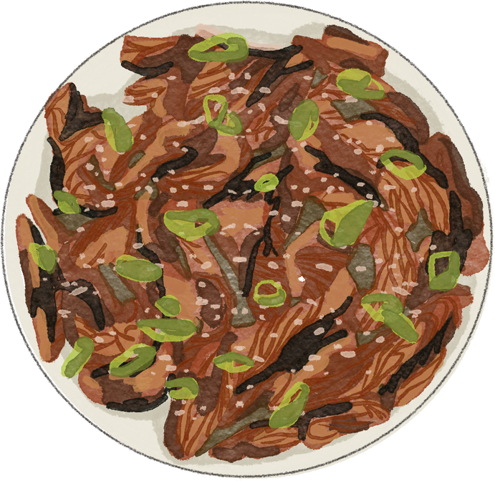

PROBLEM STATEMENT
THE RESTAURANT COMPANY IS STRUGGLING TO UNDERSTAND ITS SALES PERFORMANCE ACROSS DIFFERENT CITIES, PRODUCTS, AND MANAGERS. ALTHOUGH DETAILED SALES DATA IS AVAILABLE, THE COMPANY LACKS INSIGHTS INTO REVENUE PATTERNS AND TOP-PERFORMING AREAS. THIS ANALYSIS AIMS TO IDENTIFY KEY SALES TRENDS AND FACTORS AFFECTING OVERALL PROFITABILITY.

Slide 3
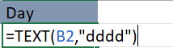
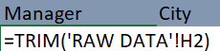
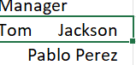

DATA CLEANING AND UNDERSTANDING
REMOVED UNWANTED SPACES AND FORMATTING ISSUES IN THE MANAGER COLUMN TO ENSURE CONSISTENCY USING TRIM FUNCTION
ADDED A NEW DAY COLUMN EXTRACTED FROM THE DATE FIELD TO ANALYZE DAILY SALES TRENDS USING TEXT FUNCTION
VERIFIED DATA TYPES AND ENSURED ALL ENTRIES WERE ACCURATE AND PROPERLY FORMATTED FOR ANALYSIS

Slide 4


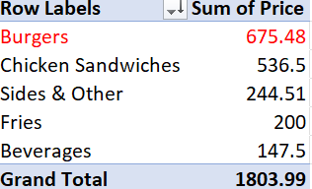
DATA STUDYING AND EXPLORATION
WHICH PRODUCTS GENERATED THE HIGHEST REVENUE?
HELPS IDENTIFY BEST-SELLERS.

Slide 5


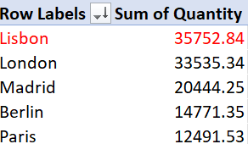

WHICH CITY CONTRIBUTES THE MOST TO OVERALL SALES?
SHOWS REGIONAL PERFORMANCE

Slide 6
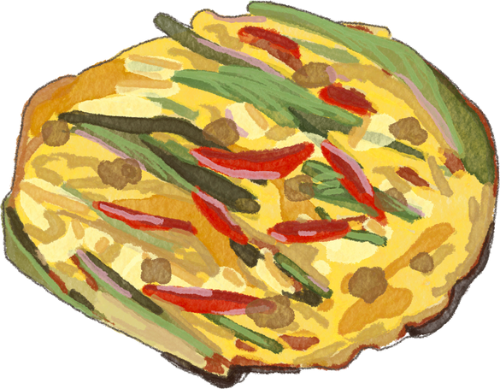
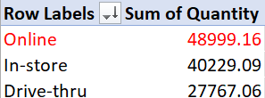
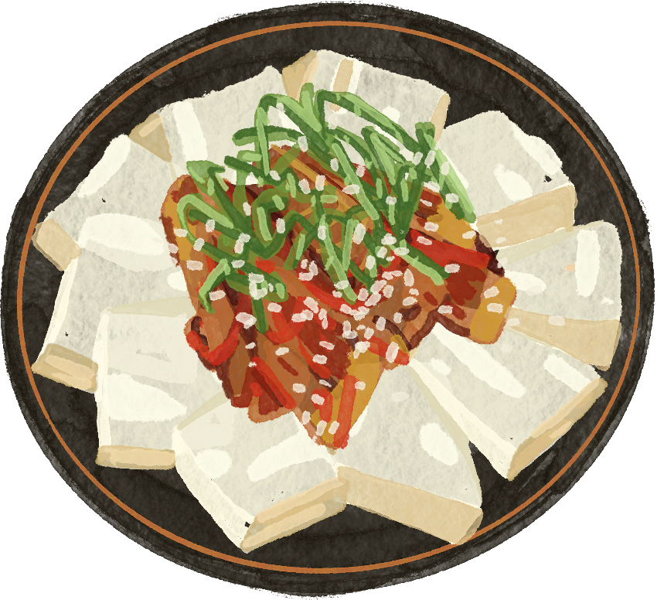

ONLINE VS. IN-STORE SALES
WHAT IS THE SALES DISTRIBUTION BETWEEN ONLINE VS. IN-STORE PURCHASES?
GOOD TO ANALYZE CUSTOMER BEHAVIOR.

Slide 7



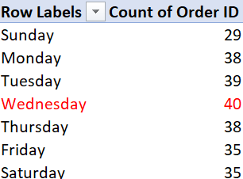
WHAT ARE THE PEAK SALES DAYS?
USEFUL FOR SPOTTING PEAK AND SLOW BUSINESS DAYS.

Slide 8
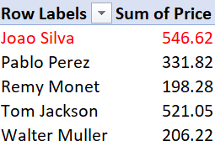
WHICH MANAGER ACHIEVED THE HIGHEST SALES REVENUE?
HELPFUL FOR PERFORMANCE EVALUATION

Slide 9

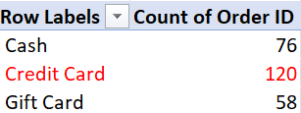


WHICH PAYMENT METHOD IS MOST PREFERRED BY CUSTOMERS?
USEFUL FOR FINANCIAL PLANNING

Slide 10
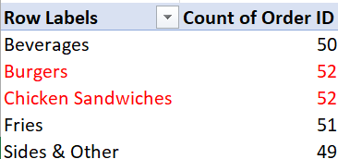
BESTSELLER
HELPS TO KNOW WHAT IS MOST DEMANDED

Slide 11
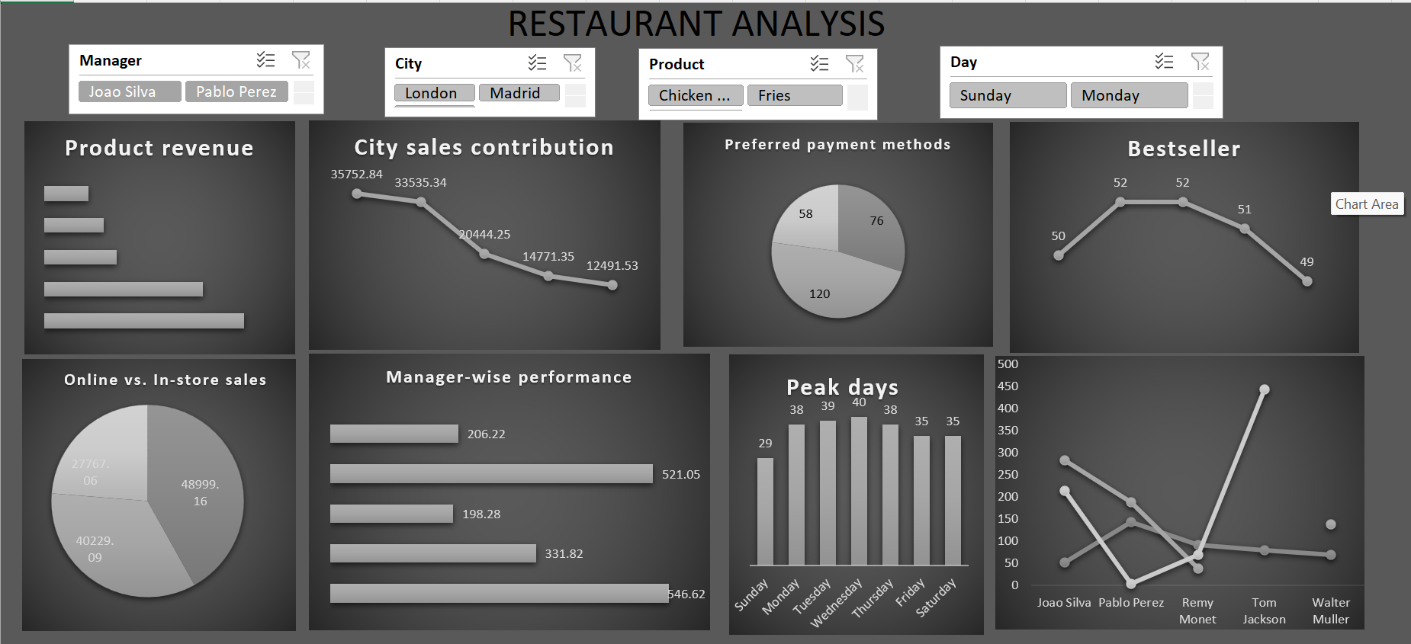
DASHBOARD SNAPSHOT

Slide 12
📊 CONCLUSIONS
BURGERS, FRIES, AND BEVERAGES ARE THE TOP REVENUE-GENERATING PRODUCTS.
IN-STORE PURCHASES CONTRIBUTE MORE TO TOTAL SALES COMPARED TO ONLINE ORDERS.
CREDIT CARD IS THE MOST PREFERRED PAYMENT METHOD AMONG CUSTOMERS.
CERTAIN CITIES OUTPERFORM OTHERS, INDICATING LOCATION-BASED SALES STRENGTHS.
MANAGER PERFORMANCE VARIES, WITH SOME CONSISTENTLY ACHIEVING HIGHER REVENUES.
DAILY TRENDS REVEAL SPECIFIC DAYS WITH PEAK SALES, USEFUL FOR PLANNING PROMOTIONS.

Slide 13




SUGGESTIONS TO GROW
INTRODUCE COMBO MEAL OFFERS (E.G., BURGERS + FRIES) TO INCREASE AVERAGE ORDER VALUE.
Boost online marketing and offers to improve digital sales.
Focus on training low-performing managers to match top performers.
Expand business in high-performing cities and improve visibility in weaker ones.
Offer loyalty points or digital wallet discounts to encourage repeat purchases.
Utilize daily trend insights to launch weekday deals and attract more customers.

Slide 14

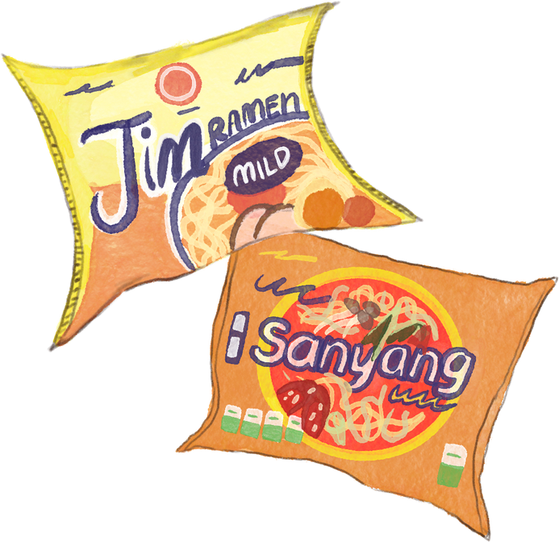
THANK YOU
KHUSHI JAGNANI
KHUSHIJAGNANI2000@GMAIL.COM

